Slide 1

Cloud Facility for Scientific Gateways J. Mike Lowe, Lead Systems Programmer Pervasive Technologies Institute, UITS/RT, Indiana University George Turner, Chief Systems Architect Pervasive Technologies Institute, UITS/RT, Indiana University CSCI-B 649, Topics in Systems Science Gateway Architectures, School of Informatics and Computing, Indiana University 24-Oct-2017
funded by the National Science Foundation
Award #ACI-1445604

Slide 2
Terms & Definitions

Slide 3
What is Jetstream

Slide 4
What is Jetstream?
User-friendly, widely accessible cloud environment
User-selectable library of preconfigured virtual machines
Interactive computing
Software maintained by domain specialist
No need for system administration skills
The “Atmosphere” side
Programmable cyberinfrastructure
Go beyond batch computing
Implement modern cloud computing techniques
Common modality for science gateways
The “API” side

Slide 5
“Long tail” of the Science
Large HPC systems requiring sophisticated
distributed memory programming skills
~3% researchers supported by the NSF
Problem size
Everyone else
Mostly node level parallelism
few
# Capable users
many
Supercomputer
Scale
laptop

Slide 6
What is Jetstream?
Primary goal is to expand the user base of NSF’s eXtreme Digital (XD) program resources beyond the current community of users.
Lowering the hurdle to onboard to XSEDE resources
Working to ease the allocation request process
Easy-Button; quick access but limited ability. (Beta)
Making Science Easy for domain researchers, engineers, & educators
Domain software installed & maintained by the professionals
No sys-admin skills necessary
Notes:
https://kb.iu.edu/d/ayep
The primary goal of the XD program is to enable major advances in science and engineering research, in the integration of research and education, and in broadening participation in science and engineering by under-represented groups, by providing researchers and educators with usable access to extreme-scale digital resources beyond those typically available on a typical campus, together with the interfaces, consulting support, and training necessary to facilitate their use.

Slide 7
What is Jetstream? (Cont.)
Creating communities
Domain developers create, install, and maintain the software
Encourage collaboration within the domains
Operating system level software is professionally patched and maintained
Repeatibility: store & publish images via IU Scholarworks & create a DOI
Science Gateways:
Notes:
https://kb.iu.edu/d/ayep
The primary goal of the XD program is to enable major advances in science and engineering research, in the integration of research and education, and in broadening participation in science and engineering by under-represented groups, by providing researchers and educators with usable access to extreme-scale digital resources beyond those typically available on a typical campus, together with the interfaces, consulting support, and training necessary to facilitate their use.

Slide 8
What is Jetstream?
Cloudy Technologies: clouds are more the just virtual machines (VM)
Old way: robust (expensive) infrastructure, weak (cheap) software
You expect the hardware to not fail
State in maintained in volatile data structures
Cloudy way: commodity infrastructure, robust software
Expect & plan for infrastructure to fail
Put intelligence into the software to handle infrastructure failure
Cows, not pets:
pets have state, you name them, you get attached to them, you put forth great amount of care and effort
cows do not have state, you expect to have high turnover, you do not get attached to them, you give them numbers instead of names
Notes:
https://kb.iu.edu/d/ayep
The primary goal of the XD program is to enable major advances in science and engineering research, in the integration of research and education, and in broadening participation in science and engineering by under-represented groups, by providing researchers and educators with usable access to extreme-scale digital resources beyond those typically available on a typical campus, together with the interfaces, consulting support, and training necessary to facilitate their use.

Slide 9
What is Jetstream?
Software layers
Atmosphere web interface
library of images, genertic, domain specific
simplify VM administration
OpenStack: software tools for building and managing cloud computing platforms for public and private clouds.
KVM hypervisor: what the VMs run on
Ceph: storage platform that stores data on a single distributed computer cluster, and provides interfaces for object-, block- and file-level storage.
Operating systems: CentOS, Ubuntu, Windows?
Applications; e.g. software developed by the domain specialist, gateways, etc.

Slide 10
API Access to Jetstream
What was unexpected
Demand for programmable cyberinfrastructure
Great platform for learning system administration skills
Great platform for teaching & learning cloudy technologies
Command line clients
Horizon dashboard very popular; but, incomplete
Programmatic control; python is popular
Slack channel for collaboration API users of Jetstream

Slide 11
OpenStack

Slide 12
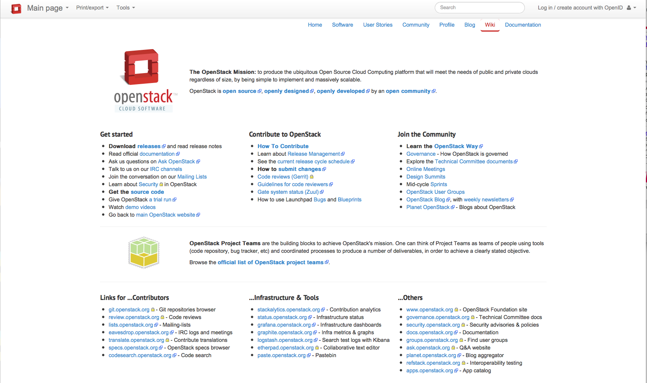
OpenStack Organization
Notes:
One does not simply install openstack
Programmable cyberinfrastructure

Slide 13
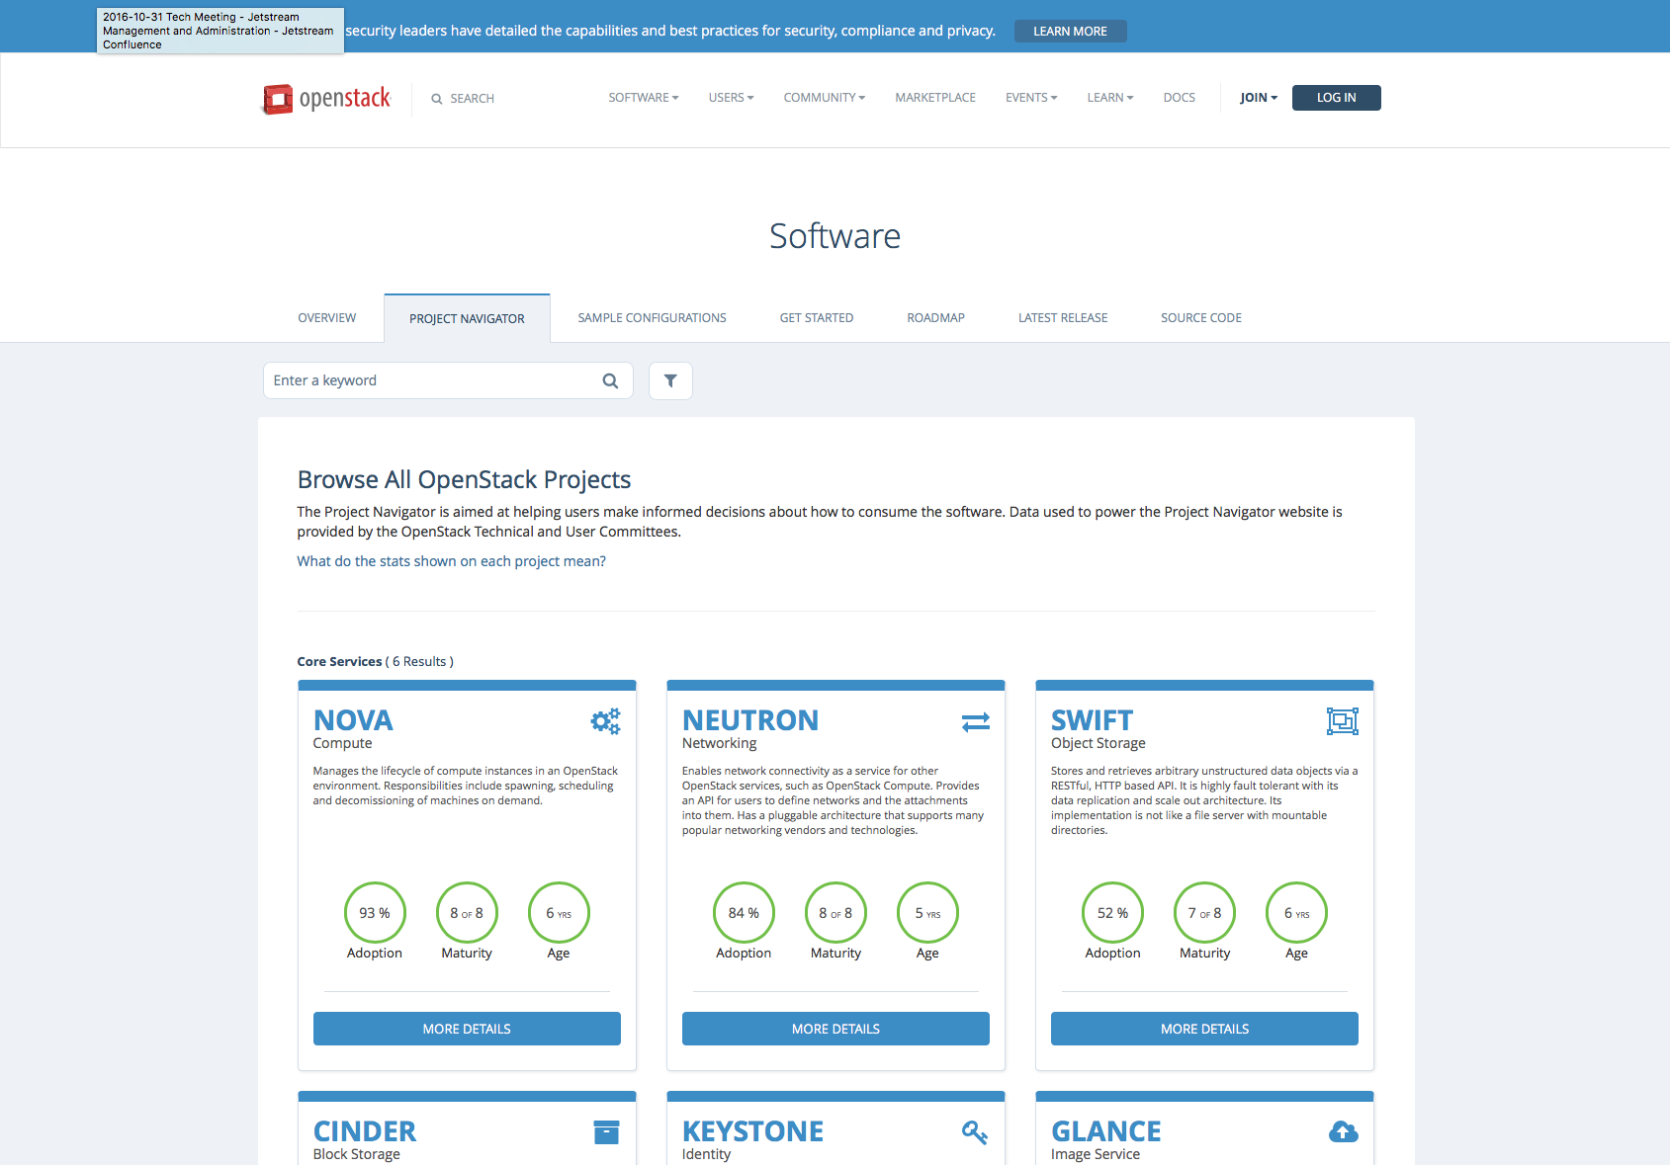
OpenStack : the Project Navigator
http://www.openstack.org/software/project-navigator/
Notes:
Openstack is actually a collection of 56 projects and a community

Slide 14
Openstack Projects …the core services
Service | Name | Adoption | Maturity | Age
Identity | Keystone | 96% | 7/8 | 5 yrs
Images | Glance | 95% | 6/8 | 7 yrs
Block device | Cinder | 88% | 7/8 | 5 yrs
Networking | Neutron | 93% | 7/8 | 5 yrs
Compute | Nova | 95% | 8/8 | 7 yrs
Object device | Swift | 52% | 7/8 | 7 yrs
https://www.openstack.org/software/project-navigator/
Notes:
https://www.openstack.org/software/project-navigator/
Adoption is the percentage of production deployments running the project based on the latest biannual user survey results.
Maturity comes from looking at 8 distinct tags that indicate stability and sustainability. The current criteria includes whether or not the project has an install guide, whether it is supported by 7 or more SDKs, if the adoption percentage is greater than 75%, whether or not the team has achieved corporate diversity and whether or not there are stable branches.
Age is the number of years the project has been in development.

Slide 15
Openstack Projects …some other services
Service | Name | Adoption | Maturity | Age
Dashboard | Horizon | 87% | 6/8 | 5 yrs
Telemetry | Ceilometer | 55% | 1/8 | 4 yrs
Orchestration | Heat | 67% | 6/8 | 4 yrs
Containers | Magnum | 11% | 2/8 | 2 yrs
Map/Reduce | Sahara | 10% | 3/8 | 3 yrs
https://www.openstack.org/software/project-navigator/
Notes:
https://www.openstack.org/software/project-navigator/
Adoption is the percentage of production deployments running the project based on the latest biannual user survey results.
Maturity comes from looking at 8 distinct tags that indicate stability and sustainability. The current criteria includes whether or not the project has an install guide, whether it is supported by 7 or more SDKs, if the adoption percentage is greater than 75%, whether or not the team has achieved corporate diversity and whether or not there are stable branches.
Age is the number of years the project has been in development.

Slide 16
Openstack Projects …some other services
Service | Name | Adoption | Maturity | Age
Shared Filesystems | Manila | 14% | 5/8 | 3 yrs
Workflow | Mistral | 5% | 1/7 | 1 yr
Load Balancing as a Service | Octavia | >0% | 1/7 | 1 yr
https://www.openstack.org/software/project-navigator/
Notes:
https://www.openstack.org/software/project-navigator/
Adoption is the percentage of production deployments running the project based on the latest biannual user survey results.
Maturity comes from looking at 8 distinct tags that indicate stability and sustainability. The current criteria includes whether or not the project has an install guide, whether it is supported by 7 or more SDKs, if the adoption percentage is greater than 75%, whether or not the team has achieved corporate diversity and whether or not there are stable branches.
Age is the number of years the project has been in development.

Slide 17
Hardware & Infrastructure

Slide 18
Production Cloud Hardware (per site)
Hardware | Number | Specifications | Function (IU)
Dell PowerEdge M630 blades | 320 | 2X Intel E5-2680v3 “Haswell” 24 cores @ 2.5 GHz 128 GB RAM 2 TB local disk | Compute hosts OpenStack services
Dell PowerEdge R630 1U server | 7 | 2X Intel E5-2680v3 “Haswell” 24 cores @ 2.5 GHz 128 GB RAM 2 TB local disk | Cluster management, High Availability, Databases, RabbitMQ
Dell PowerEdge R730xd 2U servers | 20 | 2X Intel E5-2680v3 “Haswell” 24 cores @ 2.5 GHz 64 GB RAM 48 TB storage for Ceph pool | ~1 PB Ceph storage
Dell S6000-ON network switches | 9 | 32+2 40 Gb/s ports | Top of Rack & Spine 2 to 1 Fat Tree topology

Slide 19
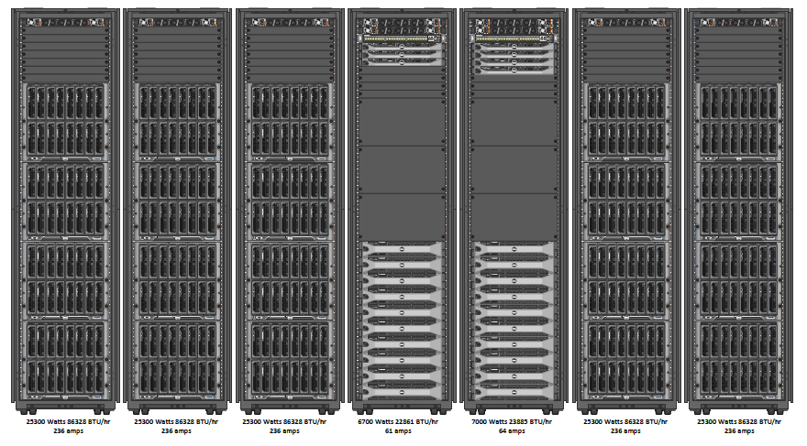
Jetstream Production Hardware

Slide 20

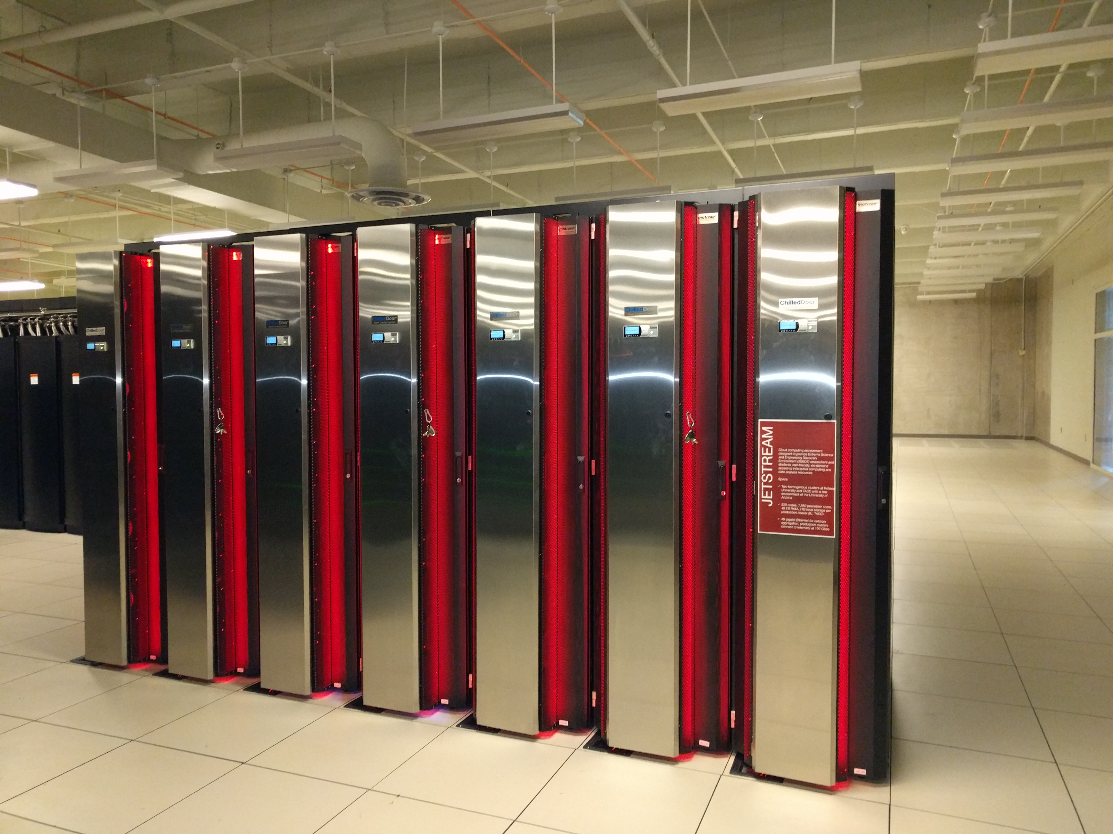
Jetstream’s Cooling Doors
½ the heat generated via Jetstream is removed via the cooling doors and ½ is removed via traditional CRACs
Colour related to health of the cooling system

Slide 21
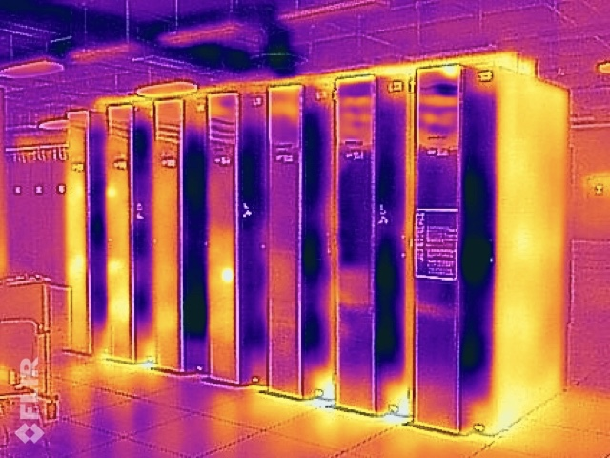
Infrared image of Jetstream
Note yellow doors on left side: this is hot air blowing from the Wrangler Storage cluster onto the cooling doors
Yellow: hot
Blue: cold

Slide 22
Benchmarks – single node

Slide 23
HPCC results : VM vs BareMetal Comparison
Benchmark | VM/ BareMetal | Units | What’s tested
HPL | 97% | FLOPS | floating point execution rate for solving a system of linear equations
DGEMM | 98% | FLOPS | floating point execution rate for double precision real matrix-matrix multiplication
Bandwidth | 88% | B/s | bytes/unit_time it takes to transmit a 2MB message from one node to another
Latency | 97% | s | time required to send an 8-byte message from one node to another
Notes:
HPCC results VM vs BareMetal HPL 97% FLOPS floating point execution rate for solving a system of linear equations DGEMM 98% FLOPS floating point execution rate for double precision real matrix-matrix multiplication MPIFFT 67% FLOPS floating point rate of execution of double precision complex one-dimensional Discrete Fourier Tranform Random 80% up/s rate of random updates of memory Stream 77% B/s sustained memory bandwidth Ptrans 64% B/s rate of transfer for large arrays of data from multiprocessor’s memory Bandwidth 88% B/s bytes/time it takes to transmit a 2,000,000 byte message from one node to another Latency 97% s time required to send an 8-byte message from one node to another FLOPS : Floating Point Operations per Second up/s : updates per second (random access; not a bandwidth measurement) B/s : Bytes per second (contiguous transfers; bandwidth measurement) s : microseconds http://icl.cs.utk.edu/hpcc/faq/

Slide 24
HPCC results : VM vs BareMetal Comparison (Cont.)
Benchmark | VM/ BareMetal | Units | What’s tested
Random | 80% | up/s | rate of random updates of memory
Stream | 77% | B/s | sustained memory bandwidth
MPI-FFT | 67% | FLOPS | floating point rate of execution of double precision complex one-dimensional Discrete Fourier Tranform
Ptrans | 64% | B/s | rate of transfer for large arrays of data from multiprocessor’s memory
Notes:
HPCC results VM vs BareMetal HPL 97% FLOPS floating point execution rate for solving a system of linear equations DGEMM 98% FLOPS floating point execution rate for double precision real matrix-matrix multiplication MPIFFT 67% FLOPS floating point rate of execution of double precision complex one-dimensional Discrete Fourier Tranform Random 80% up/s rate of random updates of memory Stream 77% B/s sustained memory bandwidth Ptrans 64% B/s rate of transfer for large arrays of data from multiprocessor’s memory Bandwidth 88% B/s bytes/time it takes to transmit a 2,000,000 byte message from one node to another Latency 97% s time required to send an 8-byte message from one node to another FLOPS : Floating Point Operations per Second up/s : updates per second (random access; not a bandwidth measurement) B/s : Bytes per second (contiguous transfers; bandwidth measurement) s : microseconds http://icl.cs.utk.edu/hpcc/faq/

Slide 25
Jetstream System Details

Slide 26
VM Instance Sizes (Flavors)
Instance Type | vCPUs | RAM(GB) | Storage(GB) | Instances/Node
Tiny | 1 | 2 | 8 | 46
Small | 2 | 4 | 20 | 23
Medium | 6 | 16 | 60 | 7
Large | 10 | 30 | 120/60* | 4
X-Large | 22 | 60 | 240/60* | 2
XX-Large | 44 | 120 | 480/60* | 1
Node config: dual Intel E-2680v3 “Haswell”, 24 physical cores/node @ 2.5 GHz, 128 GB RAM, dual 1 TB local disks.
* Effective 29-Mar-2017

Slide 27
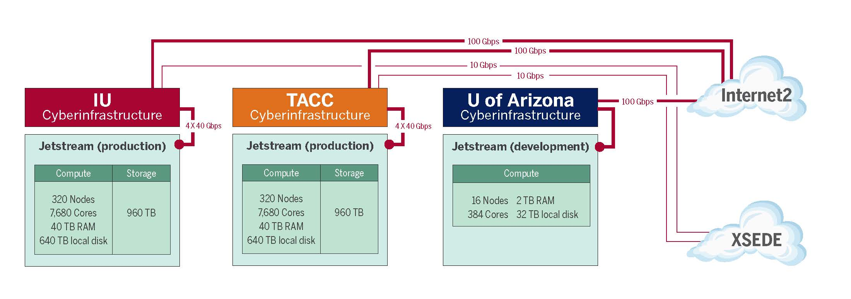
Jetstream Systems

Slide 28
Jetstream Systems (cont.)
Jetstream-IU
Internet2
XSEDE
Jetstream-AZ
100 Gb/s
Jetstream-TACC
10 Gb/s

Slide 29


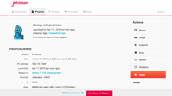

Platform Overview
Web App
Atmosphere API access
(work in progress)
Globus Auth
Atmosphere API
OpenStack API access
Atmo Services
XSEDE Accounting
OpenStack
Ceph
OpenStack
Ceph
S3 access to Ceph
Indiana University
TACC
Notes:
Note the multiple touch points for users, won’t dive deep into the architecture

Slide 30
Platform Overview
Web App
Atmosphere API access
(work in progress)
Globus Auth
Atmosphere API
OpenStack API access
Atmo Services
XSEDE Accounting
OpenStack
Ceph
OpenStack
Ceph
S3 access to Ceph
Indiana University
TACC
Notes:
Note the multiple touch points for users, won’t dive deep into the architecture

Slide 31
Platform Overview
Web App
Atmosphere API access
(work in progress)
Globus Auth
Atmosphere API
OpenStack API access
Atmo Services
XSEDE Accounting
OpenStack
Ceph
OpenStack
Ceph
S3 access to Ceph
Indiana University
TACC
Notes:
Note the multiple touch points for users, won’t dive deep into the architecture

Slide 32
Internet
HA Proxy
SSL
Controller 1
Controller 2
Controller 3
Notes:
This is not a HPC system, brings design changes
How do you take maintenance on a system where the jobs never end?

Slide 33
Load Balancer 1
I
P
1
I
P
2
Load Balancer 2
I
P
2
I
P
1
Keep Alive
DNS Round Robin
IP1 – IP2

Slide 34
High Availability layout for the databases
Spine 1
Spine 2
Top of Rack
Top of Rack
Database 1
Database 3
Database 2
Load Balancer 1
Load Balancer 2
Management

Slide 35
Glance - Cinder - Ceph
Monitor
Client
OSD 1
OSD 2
OSD N
Notes:
Ceph is now de facto standard for backing openstack deployments
Boot and login time 8-12 seconds

Slide 36
Ceph
Qemu
Object 1
VM
Object 2
disk
RBD
Object 3
Object N
Notes:
This slide needs a title

Slide 37
OpenStack Overview
Glance
Keystone
Compute
Client
Token
Ceph
Nova
Cinder

Slide 38
VXLAN Packet
Ethernet
IP/UDP
Ethernet
IP

Slide 39
Neutron Networking
Hypervisor
VM
Network
node
VXLAN
Bridge
Bridge
VXLAN
Tap
NetNS
Tap
Hypervisor
Bridge
VM
Internet
Bridge
VXLAN

Slide 40
Network Topology (cont.) Chassis
To Top of Rack Switches
Chassis
Sixteen blades per chasses
Two switches per chassis
8 Blades
S
w
I
t
c
h
S
w
I
t
c
h
8 Blades
Cooling
10 Gb/s
per blade
10 GB/s
per blade
Cooling
10 Gb/s
40 Gb/s
LAG
2 x 40 Gb/s
Inter-switch
links

Slide 41
Network Topology (cont.) Chassis to Top of Rack
Top of Rack
Switch
40 Gb/s
LAG
Four chassis per rack
Two switches per chassis

Slide 42
Network Topology (cont.)
100 Gb/s uplink to Internet2
40 Gb/s
Two spines tie into two network blades in the datacenter switch
LAG
Spine 1
Spine 2
Seven racks tie into
the two spine switches
Top of Rack
Top of Rack
Top of Rack
40 Gb/s
Notes:
Link Aggregation Group (LAG) combines a number of physical ports together to make a single high-bandwidth data path, so as to implement the traffic load sharing among the member ports in the group and to enhance the connection reliability.

Slide 43
How do we onboard users onto Jetstream?
An XSEDE User Portal (XUP) account is required. They are free! Get one at https://portal.xsede.org
Work with your XSEDE Campus Champion.
Submit an allocations request
Read the Allocations Overview - https://portal.xsede.org/allocations-overview
Writeup an allocation request – start with a Startup or Education request - https://portal.xsede.org/successful-requests
Easy Button: instant access to small, limited instances while the allocation request is processed and the user is vetted.

Slide 44
Jetstream Information Sources
Twitter: @jetstream-cloud
Jetstream’s web interface: https://use.jetstream-cloud.org/
No login required to browse image library
XSEDE User Portal account is required to actually login: https://portal.xsede.org Create account in seconds.
Jetstream Home page: https://jetstream-cloud.org/
Jetstream’s public documentation: https://wiki.jetstream-cloud.org

Slide 45
Jetstream Information Sources (Cont.)
Paper describing Jetstream Jetstream: A self-provisioned, scalable scince and engineering cloud environment
Configuration management: https://github.com/jetstream-cloud/Jetstream-Salt-States
For questions, comments, etc. of any manner
help@jetstream-cloud.org

Slide 46











Jetstream Partners

Slide 47
Questions?
Project website: http://jetstream-cloud.org/
Project email: jethelp@iu.edu
Direct email: jomlowe@iu.edu, turnerg@iu.edu
License Terms
Lowe, J.M., Turner G.W. 2017. Jetstream: Cloud Facility for Scientific Gateways: CSCI0B 649, Topics in Systems, Science Gateway Architectures; Computer Science, School of Informatics and Computing, Indiana University. Also available at: http://jetstream-cloud.org/publications.php
Jetstream is supported by NSF award 1445604 (Craig Stewart, IU, PI)
XSEDE is supported by NSF award 1053575 (John Towns, UIUC, PI)
This research was supported in part by the Indiana University Pervasive Technology Institute, which was established with the assistance of a major award from the Lilly Endowment, Inc. Opinions presented here are those of the author(s) and do not necessarily represent the views of the NSF, IUPTI, IU, or the Lilly Endowment, Inc.
Items indicated with a © are under copyright and used here with permission. Such items may not be reused without permission from the holder of copyright except where license terms noted on a slide permit reuse.
Except where otherwise noted, contents of this presentation are copyright 2015 by the Trustees of Indiana University.
This document is released under the Creative Commons Attribution 3.0 Unported license (http://creativecommons.org/licenses/by/3.0/). This license includes the following terms: You are free to share – to copy, distribute and transmit the work and to remix – to adapt the work under the following conditions: attribution – you must attribute the work in the manner specified by the author or licensor (but not in any way that suggests that they endorse you or your use of the work). For any reuse or distribution, you must make clear to others the license terms of this work.

